Slide 1


Data Structures
ETCCBD201
Ms. Jyoti Yadav
Faculty
School of Engineering & Technology
K.R. Mangalam University
Unit 2 : Linear Data Structures

Slide 2

Unit-2 Linear Data Structures
SESSION 11 Arrays – 1D & 2D
SESSION 12 Static & Dynamic Arrays
SESSION 13 Linked Lists Types
SESSION 14 Linked List Operations
SESSION 15 Stack ADT & Operations
SESSION 16 Stack Applications
SESSION 17 Queue ADT
SESSION 18 Queue Applications
SESSION 19 BFS using Queue
SESSION 20 Revision (Unit–2)
Notes:
New Courses replaced with New Programmes

Slide 3
Queue Applications
Session 18
Introduction to Queue Applications
Why FIFO is important for real systems
Applications of Queue – Overview
CPU Scheduling
Printer Spooling
Process Synchronization
Breadth-First Search (BFS)
Network Packet Handling
Customer Service Systems
Traffic Management Systems
Circular Queue – Need & Concept
Circular Queue Operations & Algorithms (Array)
Complexity, Advantages & Disadvantages of Circular Queue
Applications of Circular Queue
Priority Queue – Concept & Operations
Priority Queue Implementations (Array/Heap/Linked List)
Key Takeaways
References
Notes:
New Courses replaced with New Programmes

Slide 4
Recapitulation (Queue ADT)
Queue follows the FIFO principle.
Insertion is done using enqueue at the rear.
Deletion is done using dequeue from the front.
Implementations: array-based and linked-list-based.
Overflow occurs when the queue is full; underflow occurs when it is empty.
Queues are essential for scheduling, buffering, and graph traversal.
Notes:
New Courses replaced with New Programmes

Slide 5
Quick Quiz
Fill in the Blanks
Queue follows the __________ principle.
The pointer that indicates the first element is called __________.
The operation used to insert an element is __________.
Queue underflow occurs when __________.
One-Word / Short Answer
Which operation removes an element from a queue?
Name one application of queue.
Which implementation allows dynamic size?
Which pointer is updated during enqueue?
Notes:
New Courses replaced with New Programmes

Slide 6
Quick Quiz
Why is queue suitable for CPU scheduling?
Why is array-based queue inefficient in some cases?
Notes:
New Courses replaced with New Programmes

Slide 7
Quick Quiz (Answers)
FIFO
Front
Enqueue
deleting from empty queue
Dequeue
printer spooling/CPU scheduling
linked list
Rear
fairness/order
fixed size & memory wastage.
Notes:
New Courses replaced with New Programmes

Slide 8
Learning Objectives
After this lecture, students will be able to:
Explain how queues are used in operating systems, networking, and algorithms
Describe the role of FIFO in CPU scheduling, buffering, and BFS
Differentiate between linear queue, circular queue, deque, and priority queue
Apply queue operations to solve real-world problems
Analyze time complexity of queue-based algorithms
Choose an appropriate queue type for a given application
Notes:
New Courses replaced with New Programmes

Slide 9
Applications of Queue
CPU Scheduling
Printer Spooling
Process Synchronization
Breadth-First Search (BFS)
Network Packet Handling
Customer Service Systems
Traffic Management System
Notes:
New Courses replaced with New Programmes

Slide 10
CPU Scheduling Explanation
In operating systems, multiple processes wait for CPU time. A queue stores ready processes in FIFO order. The CPU executes them one by one.
Queue ensures fairness – first process to arrive gets executed first.
Process P1 P2 P3 P4
↓ ↓ ↓ ↓
┌──────────────────┐
│ READY QUEUE │ (FIFO)
└──────────────────┘
↓
CPU
Notes:
New Courses replaced with New Programmes

Slide 11
Printer Spooling
Print jobs are stored in a queue before printing. The printer processes them in the order received.
Queue prevents job conflicts and maintains order.
PC1 PC2 PC3
↓ ↓ ↓
┌─────────────────┐
│ PRINT QUEUE │
└─────────────────┘
↓
Printer
Notes:
New Courses replaced with New Programmes

Slide 12
Process Synchronization
When multiple processes need a shared resource (file, database, memory), they wait in a queue to access it safely.
Queue avoids race conditions and ensures orderly access.
Process A Process B Process C
↓ ↓ ↓
┌──────────────────────┐
│ RESOURCE QUEUE │
└──────────────────────┘
↓
Shared Resource
Notes:
New Courses replaced with New Programmes

Slide 13
Breadth-First Search (BFS)
BFS uses a queue to explore graph nodes level by level.
Queue maintains correct visiting order.
Graph Levels:
A
/ \
B C
| |
D E
Queue during BFS:
Front → [A, B, C, D, E] → Rear
Notes:
New Courses replaced with New Programmes

Slide 14
Network Packet Handling
Routers store incoming data packets in a queue before sending them to the destination.
Queue controls traffic and avoids data loss.
Incoming Packets
P1 P2 P3 P4
↓ ↓ ↓ ↓
┌──────────────────┐
│ PACKET QUEUE │
└──────────────────┘
↓
Network Link
Notes:
New Courses replaced with New Programmes

Slide 15
Customer Service Systems
Customers wait in a queue at banks, ticket counters, or call centers.
Queue implements first-come, first-served service.
Customers:
C1 → C2 → C3 → C4
┌────────────┐
│ QUEUE │
└────────────┘
↓
Service Desk
Notes:
New Courses replaced with New Programmes

Slide 16
Traffic Management Systems
Vehicles at traffic signals are treated as a queue.
Queue maintains order and smooth traffic flow.
Cars:
🚗 → 🚙 → 🚕 → 🚌
┌────────────┐
│ QUEUE │
└────────────┘
↓
Traffic Signal
Notes:
New Courses replaced with New Programmes

Slide 17
Check Your Understanding
Fill in the blanks
Queue follows the __________ principle.
In CPU scheduling, processes wait in the __________ queue.
BFS explores nodes __________ by __________.
In printer spooling, print jobs are processed in __________ order.
Short answer
Why is queue suitable for customer service systems?
Name one networking application of queue.
Notes:
New Courses replaced with New Programmes

Slide 18
Check Your Understanding (Answers)
FIFO
Ready
level by level
arrival/FIFO
Fairness
packet buffering/routing.
Notes:
New Courses replaced with New Programmes

Slide 19

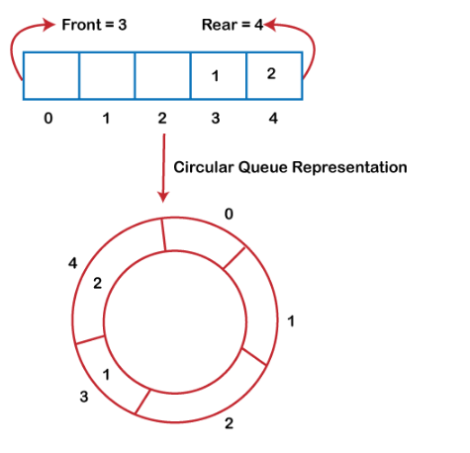
Why was the circular queue?
If the rear reaches to the end position of the Queue then there might be possibility that some vacant spaces are left in the beginning which cannot be utilized. So, to overcome such limitations, the concept of the circular queue was introduced.
https://www.javatpoint.com/data-structure-queue
Notes:
New Courses replaced with New Programmes

Slide 20
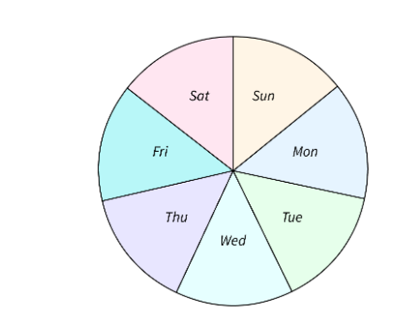
Circular Queue?
It is also based on the FIFO (First In First Out) principle except that the last position is connected to the first position in a circular queue that forms a circle. It is also known as a Ring Buffer.
https://www.scaler.com/topics/data-structures/queue-in-data-structure/
Notes:
New Courses replaced with New Programmes

Slide 21
Operations
Front: It is used to get the front element from the Queue.
Rear: It is used to get the rear element from the Queue.
EnQueue(value): This function is used to insert the new value in the Queue. The new element is always inserted from the rear end.
DeQueue(): This function deletes an element from the Queue. The deletion in a Queue always takes place from the front end.
https://www.youtube.com/watch?app=desktop&v=gYxdHbbjn_8
Notes:
New Courses replaced with New Programmes

Slide 22
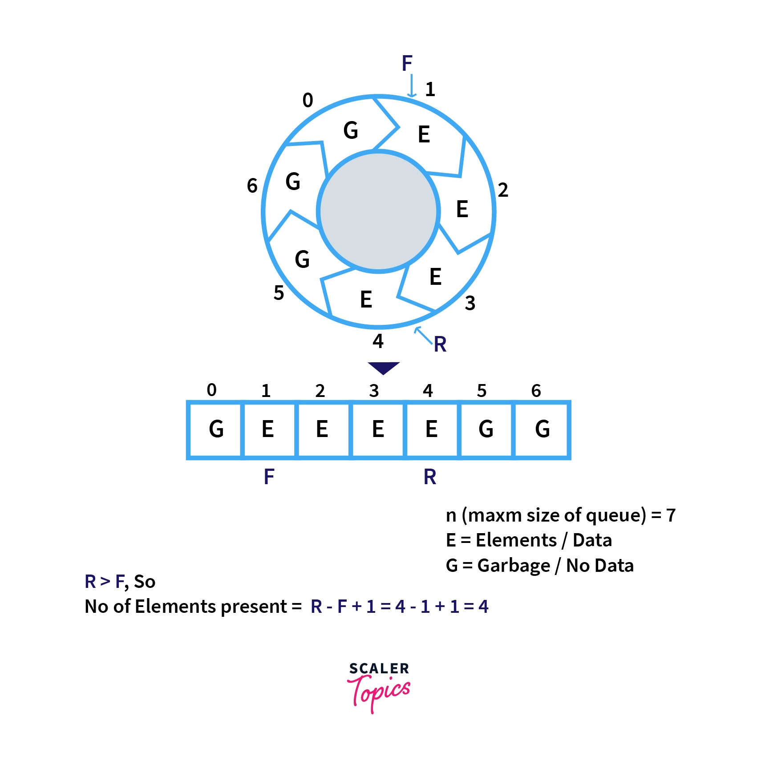
Representation using Array
https://www.youtube.com/watch?app=desktop&v=gYxdHbbjn_8
Notes:
New Courses replaced with New Programmes

Slide 23
Implement Circular Queue using Array:
Insertion
Step 1 : If FRONT = (REAR + 1) % MAXSIZE : then
Write : “Queue Overflow” and return.
[End of If structure]
Step 2 : Read NUM to be inserted in Circular Queue.
Step 3 : If FRONT= -1 : then
Set FRONT = REAR =0.
Else
Set REAR=(REAR + 1) % MAXSIZE.
[End of If Else structure]
Step 4 : Set CQUEUE[REAR]=NUM;
Step 5 : Exit
Notes:
New Courses replaced with New Programmes

Slide 24
Implement Circular Queue using Array:
Deletion
Step 1 : If FRONT = - 1 : then
Write : “Queue Underflow” and return.
[End of If Structure]
Step 2 : Set NUM = CQUEUE[FRONT].
Step 3 : Write ‘Deleted element from circular queue is : ",NUM.
Step 4 : If FRONT = REAR : then
Set FRONT = REAR = -1;
Else
Set FRONT = (FRONT + 1) % MAXSIZE.
Step 5 : Exit
Notes:
New Courses replaced with New Programmes

Slide 25
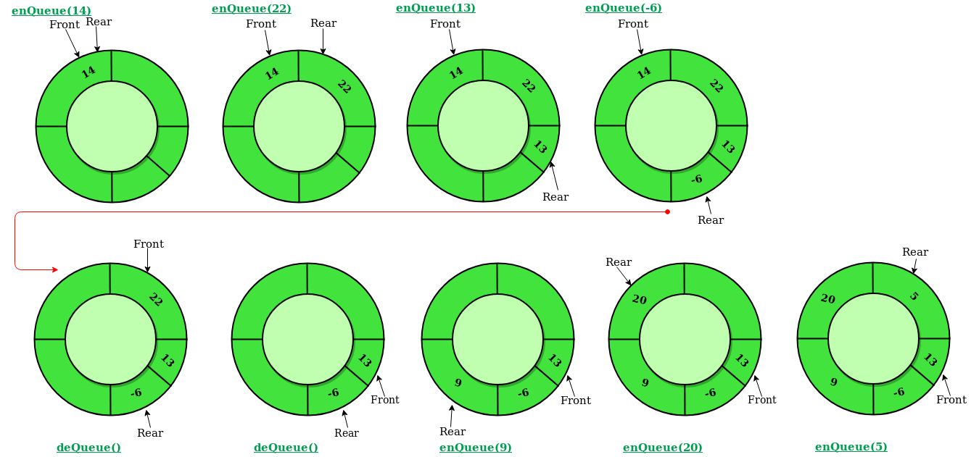
Illustration of Circular Queue Operations:
https://www.geeksforgeeks.org/introduction-to-circular-queue/
Notes:
New Courses replaced with New Programmes

Slide 26
Complexity Analysis of Circular Queue Operations
Time Complexity:
Enqueue: O(1) because no loop is involved for a single enqueue.
Dequeue: O(1) because no loop is involved for one dequeue operation.
Auxiliary Space: O(N) as the queue is of size N.
Notes:
New Courses replaced with New Programmes

Slide 27
Advantages of Circular Queue Operations
Advantages:
Efficient space utilization: Circular queues efficiently use the available memory space.
No shifting of elements: Elements are continuously added and removed without the need to shift remaining elements.
Simple implementation: It's relatively straightforward to implement a circular queue using an array.
Notes:
New Courses replaced with New Programmes

Slide 28
Disadvantage of Circular Queue Operations
Disadvantages:
Fixed size: Circular queues have a fixed capacity determined by the size of the underlying array.
Potential for confusion: The circular nature of the queue can sometimes lead to confusion in understanding its behavior, especially with wraparound scenarios.
Notes:
New Courses replaced with New Programmes

Slide 29
Applications of Circular Queue Operations
Applications:
Operating systems for managing task scheduling.
Networking for managing packets in routers and switches.
Memory management in embedded systems.
Simulation of resource allocation scenarios.
Notes:
New Courses replaced with New Programmes

Slide 30
Code for insertion &deletion Operation Of Queue (Python)
queue = [0] * 5
front = -1
rear = -1
size = 5
def enqueue(value):
global front, rear
if rear == size - 1:
print("Queue Overflow")
else:
if front == -1:
front = 0
rear += 1
queue[rear] = value
print(value, "inserted")
def dequeue():
global front, rear
if front == -1 or front > rear:
print("Queue Underflow")
else:
print("Deleted element:", queue[front])
front += 1
# Example usage
enqueue(10)
enqueue(20)
enqueue(30)
dequeue()
dequeue()
Notes:
New Courses replaced with New Programmes

Slide 31
Code for insertion &deletion Operation Of Queue (C++)
// C++ program for insertion and
// deletion in Circular Queue
#include <bits/stdc++.h>
using namespace std;
// Structure of a Node
struct Node {
int data;
struct Node* link;
};
struct Queue {
struct Node *front, *rear;
};
Notes:
New Courses replaced with New Programmes

Slide 32
Code for insertion &deletion Operation Of Queue (C++)
// Function to create Circular queue
void enQueue(Queue* q, int value)
{
struct Node* temp = new Node;
temp->data = value;
if (q->front == NULL)
q->front = temp;
else
q->rear->link = temp;
q->rear = temp;
q->rear->link = q->front;
}
Notes:
New Courses replaced with New Programmes

Slide 33
Code for insertion &deletion Operation Of Queue (C++)
// Function to delete element from Circular Queue
int deQueue(Queue* q)
{
if (q->front == NULL) {
cout << "Queue is empty";
return INT_MIN;
}
// If this is the last node to be deleted
int value; // Value to be dequeued
if (q->front == q->rear) {
value = q->front->data;
free(q->front);
q->front = NULL;
q->rear = NULL;
}
Notes:
New Courses replaced with New Programmes

Slide 34
Code for insertion &deletion Operation Of Queue (C++)
else // There are more than one nodes
{
struct Node* temp = q->front;
value = temp->data;
q->front = q->front->link;
q->rear->link = q->front;
free(temp);
}
return value;
}
// Function displaying the elements of Circular Queue
void displayQueue(struct Queue* q)
{
struct Node* temp = q->front;
cout << endl << "Elements in Circular Queue are: ";
while (temp->link != q->front) {
cout << temp->data << " ";
temp = temp->link;
}
cout << temp->data;
}
Notes:
New Courses replaced with New Programmes

Slide 35
Code for insertion &deletion Operation Of Queue (C++)
/* Driver of the program */
int main()
{
// Create a queue and initialize front and rear
Queue* q = new Queue;
q->front = q->rear = NULL;
// Inserting elements in Circular Queue
enQueue(q, 14);
enQueue(q, 22);
enQueue(q, 6);
// Display elements present in Circular Queue
displayQueue(q);
// Deleting elements from Circular Queue
cout << endl << "Deleted value = " << deQueue(q);
cout << endl << "Deleted value = " << deQueue(q);
// Remaining elements in Circular Queue
displayQueue(q);
enQueue(q, 9);
enQueue(q, 20);
displayQueue(q);
return 0;
}
Notes:
New Courses replaced with New Programmes

Slide 36
Output
Elements in Circular Queue are:
14 22 6
Deleted value = 14
Deleted value = 22
Elements in Circular Queue are: 6
Elements in Circular Queue are: 6 9 20;
Notes:
New Courses replaced with New Programmes

Slide 37
Test Yourself
The circular Queue of capacity (n - 1) is used in an array of n elements. Assume that insert and deletion functions are performed using REAR and FRONT as the variable index of Array, respectively. Initially, REAR = FORWARD = 0. The conditions for finding the Queue are full and empty.
(REAR+1) mod n == FRONT, empty: REAR == FRONT.
empty: (FRONT+1) mod n == REAR,(REAR+1) mod n == FRONT
empty: (REAR+1) mod n == FRONT, REAR == FRONT
(FRONT+1) mod n == REAR, empty: REAR == FRONT.
Solution: a. (REAR+1) mod n == FRONT, empty: REAR == FRONT
Notes:
New Courses replaced with New Programmes

Slide 38
Test Yourself
A standard circular Queue 'q' implemented whose size is 11 from 0 to 10. The front & rear pointers start to point at q[2]. The ninth element be added at which position?
q[0]
q[1]
q[9]
q[10]
Solution: a. q[0]
Notes:
New Courses replaced with New Programmes

Slide 39
Test Yourself
Choose the incorrect statement?
If Queue is implemented through the linked list, keeping track of a front pointer will change only rear pointer "s" during insertion into non-empty Queue.
The Queue can be used to implement the least recently used page fault algorithm and Quicksort algorithm.
The Queue can be used to implement the Quicksort algorithm but not least recently used (LRU) page fault algorithm.
Both (A) and (C)
Solution: c. The Queue can be used to implement the Quicksort algorithm but not least recently used (LRU) page fault algorithm.
Notes:
New Courses replaced with New Programmes

Slide 40
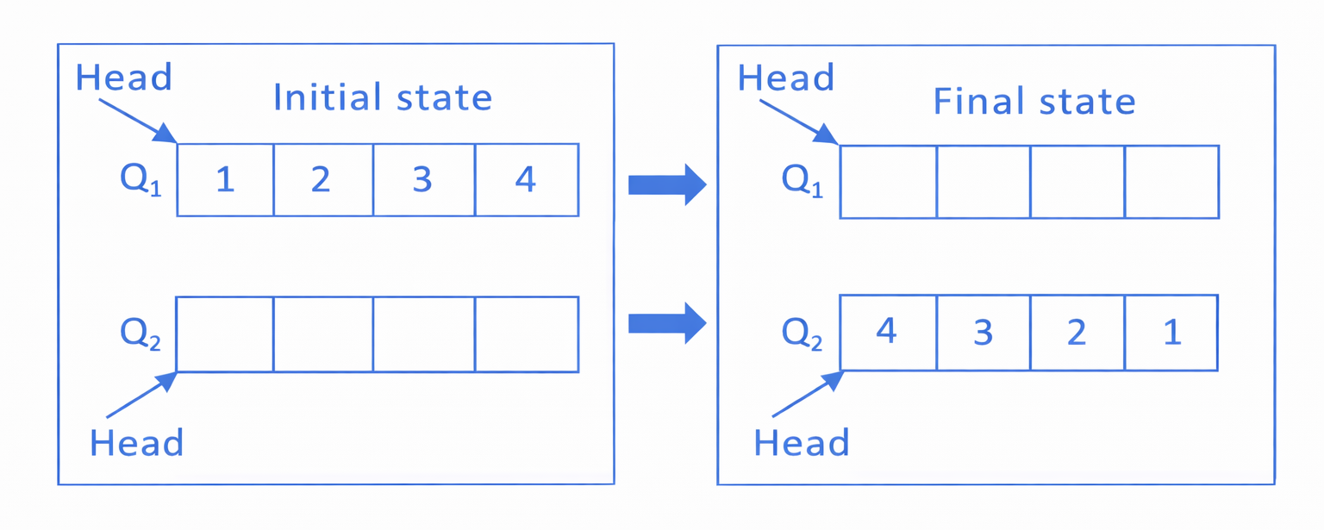
Test Yourself
Consider the queues Q₁ containing four elements and Q₂ containing none (shown as the Initial State in the figure). The only operations allowed on these two queues are Enqueue (Q, element) and Dequeue (Q). The minimum number of Enqueue operations on Q₁ required to place the elements of Q₁ in Q₂ in reverse order (shown as the Final State in the figure) without using any additional storage is ______________.
Notes:
New Courses replaced with New Programmes

Slide 41
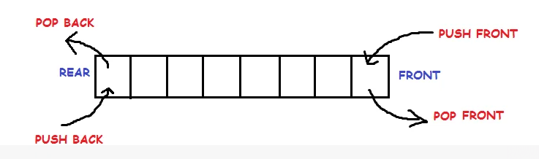
Doubly Ended Queue
Notes:
New Courses replaced with New Programmes

Slide 42
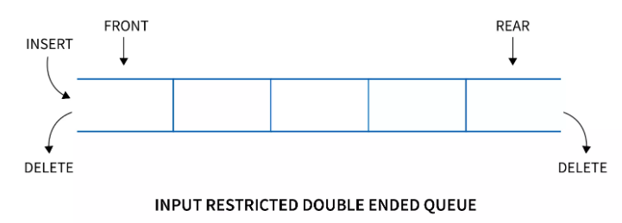
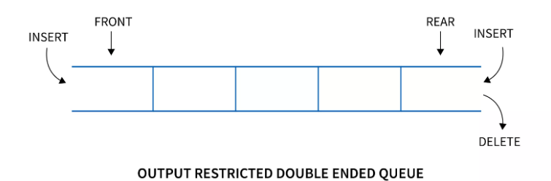
Doubly Ended Queue
Types
Input restricted queue
Output restricted queue
Notes:
New Courses replaced with New Programmes

Slide 43
Operations performed on Deque
There are the following operations that can be applied on a deque -
Insertion at front
Insertion at rear
Deletion at front
Deletion at rear
Get the front item from the deque
Get the rear item from the deque
Check whether the deque is full or not
Checks whether the deque is empty or not
Notes:
New Courses replaced with New Programmes

Slide 44
Assignmentunit2 _1
Convert the given expression from infix to postfix
( a + b ) * ( c + d * e) * f
a – b * c / d + e
Evaluate the given postfix expression by using the stack concept
5 5 2 3 + 6 * + 3 + *
10 8 + 5 * - 2
a) Write the pseudo code for Push and pop operations from the stack. Give a suitable example.
b) Write the pseudo code for insertion and deletion from Queue.
Notes:
New Courses replaced with New Programmes

Slide 45
Assignmentunit2 _1
4. Fill in the blank
In a stack, the operation of removing an item is called _______.
The basic principle of _______ is Last In, First Out (LIFO).
5. Consider a stack that initially contains 5 elements. If you perform 3 push operations and 2 pop operations, what is the current size of the stack?
6. If you have a queue with 10 elements and you perform 5 dequeue operations followed by 7 enqueue operations, how many elements does the queue contain now?
Notes:
New Courses replaced with New Programmes

Slide 46
Assignmentunit2 _1
One way to implement a queue is to use a circular linked list. In a circular linked list, the last node’s next pointer points at the first node. Assume the list does not contain a header and that we can maintain, at most, one iterator corresponding to a node in the list. For which of the following representations can all basic queue operations be performed in constant worst-case time? Justify your answers.
Maintain an iterator that corresponds to the first item in the list.
Maintain an iterator that corresponds to the last item in the list
Notes:
New Courses replaced with New Programmes

Slide 47
Assignmentunit2 _1
8. Draw the queue structure in each case when the following operations are performed on an empty queue.
(a) Add A, B, C, D, E, F
(b) Delete two letters
(c) Add G
(d) Add H
(e) Delete four letters
(f) Add I
Notes:
New Courses replaced with New Programmes

Slide 48
Assignmentunit2 _1
9. Consider the following sequence of operations on an empty stack.
push(54); push(52); pop(); push(55); push(62); s = pop();
Consider the following sequence of operations on an empty queue.
enqueue(21); enqueue(24); dequeue(); enqueue(28); enqueue(32); q = dequeue();
The value of s + q is ____
Notes:
New Courses replaced with New Programmes

Slide 49
Assignmentunit2 _1
10. Consider the following Circular queue where CIRCULAR QUEUE is allocated 6 memory cells: Front=2, Rear=5
QUEUE: __________, London, Berlin, Rome, Paris, _________
Describe the Queue including FRONT and REAR as the following operations take place:
Athens is added
Two cities are deleted
Madrid is added
Moscow is added
Three cities are deleted
Oslo is added
Write an algorithm to perform insertion of new element in Circular Queue?
Notes:
New Courses replaced with New Programmes

Slide 50

Priority Queues
https://www.simplilearn.com/tutorials/data-structure-tutorial/priority-queue-in-data-structure
Notes:
New Courses replaced with New Programmes

Slide 51
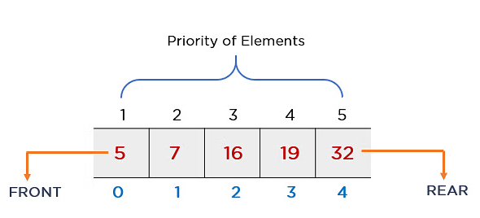
Priority Queues
The priority of elements determines the order of removal in a queue, i.e., the element with higher priority will leave the queue first, whereas the element with the lowest priority at last
https://www.simplilearn.com/tutorials/data-structure-tutorial/priority-queue-in-data-structure
Notes:
New Courses replaced with New Programmes

Slide 52
Priority Queues
Priority Order
Ascending Order
Descending Order
Notes:
New Courses replaced with New Programmes

Slide 53
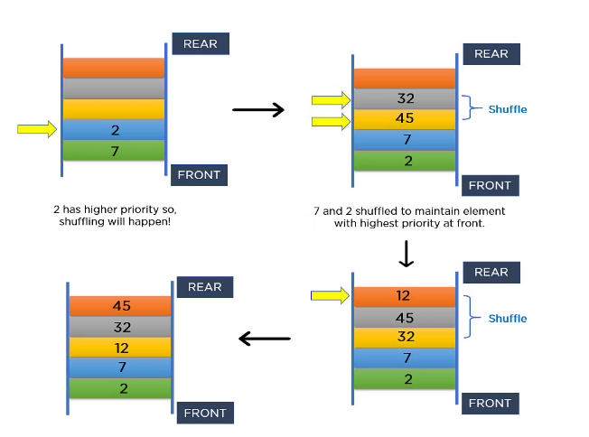
Priority Queues
https://www.simplilearn.com/tutorials/data-structure-tutorial/priority-queue-in-data-structure
Notes:
New Courses replaced with New Programmes

Slide 54
Priority Queues
https://www.simplilearn.com/tutorials/data-structure-tutorial/priority-queue-in-data-structure
Notes:
New Courses replaced with New Programmes

Slide 55
Priority Queue Applications
Operating systems
Time-activated events
Managing responsibilities
Sorting
Djikstra’s Algorithm
Prim’s Algorithm
Notes:
New Courses replaced with New Programmes

Slide 56
Implementation of Priority Queue
Using Linked List
Using Binary Heap
Using Array
Binary Search Tree
Notes:
New Courses replaced with New Programmes

Slide 57
Operation on Priority Queue
Insertion:
Insertion operation is used to insert a new element into the queue. Whenever a new element is inserted,
The new element is moved to an empty slot top to bottom and left to right.
If the inserted element is not in the correct position. It will be compared with the parent element.
And if the element is not in the correct order, then elements are swapped until the inserted element gets to the correct position.
Notes:
New Courses replaced with New Programmes

Slide 58
Operation on Priority Queue
Algorithm:
if (the queue is empty)
Create a node
else //when node is already present
Insert the new node at the end of the queue (last node from left to right) heapify the array
Notes:
New Courses replaced with New Programmes

Slide 59
Operation on Priority Queue
Deletion:
Deletion operation is used to remove any element from the queue, For deleting any element,
Choose the element which needs to be deleted.
Swap it with the last element.
Remove the last element
Heapify the array.
Notes:
New Courses replaced with New Programmes

Slide 60
Operation on Priority Queue
Deletion:
Algorithm:
if (node== leaf node)
delete node
else //when node is not leaf node
Swap node with leaf node
Delete the leaf node
heapify the array
Notes:
New Courses replaced with New Programmes

Slide 61
Implementation of Priority Queue Using Array:
The basic implementation using array is:
struct node
{
int node:
int priority:
}
Notes:
New Courses replaced with New Programmes

Slide 62
Implementation of Priority Queue Using Array:
Operations in array:
enqueue(): It is used to insert new element into the priority queue.
dequeue(): It removes an element with the highest priority from the priority queue.
peek(): It is used to determine the highest priority element in the queue without removing it.
Notes:
New Courses replaced with New Programmes

Slide 63
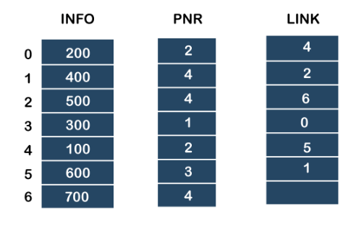
Implementation of Priority Queue
https://www.javatpoint.com/ds-priority-queue
Notes:
New Courses replaced with New Programmes

Slide 64
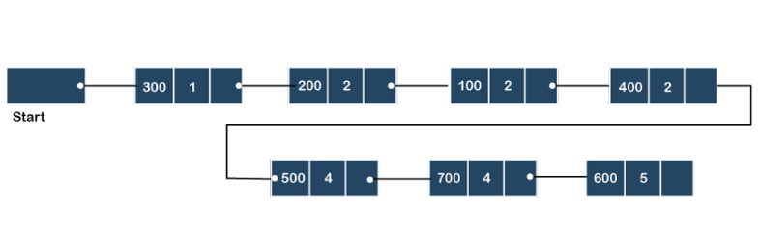
Implementation of Priority Queue
Using link list
https://www.javatpoint.com/ds-priority-queue
Notes:
New Courses replaced with New Programmes

Slide 65
Algorithm for Insertion at rear end
Step-1: [Check for overflow]
if(rear==MAX)
Print("Queue is Overflow”);
return;
Step-2: [Insert Element]
else
rear=rear+1;
q[rear]=no;
[Set rear and front pointer]
if rear=0
rear=1;
if front=0
front=1;
Step-3: return
Notes:
New Courses replaced with New Programmes

Slide 66
Algorithm for Insertion at front end
Step-1 : [Check for the front position]
if(front<=1)
Print("Cannot add item at the front”);
return;
Step-2 : [Insert at front]
else
front=front-1;
q[front]=no;
Step-3 : Return
Notes:
New Courses replaced with New Programmes

Slide 67
Algorithm for Deletion from front end
Step-1 [ Check for front pointer]
if front=0
print(" Queue is Underflow”);
return;
Step-2 [Perform deletion]
else no=q[front];
print(“Deleted element is”,no);
[Set front and rear pointer]
if front=rear
front=0;
rear=0;
else front=front+1;
Step-3 : Return
Notes:
New Courses replaced with New Programmes

Slide 68
Algorithm for Deletion from rear end
Step-1 : [Check for the rear pointer]
if rear=0
print(“Cannot delete value at rear end”);
return;
Step-2: [ perform deletion]
else no=q[rear];
[Check for the front and rear pointer]
if front= rear
front=0;
rear=0;
else rear=rear-1;
print(“Deleted element is”,no);
Step-3 : Return
Notes:
New Courses replaced with New Programmes

Slide 69
Complexity
Insertion or deletion in the middle is O(n)
The time complexity of random access by index is O(1)
Time complexity of all enque (insert)/deque(delete) operations is O(1)
Notes:
New Courses replaced with New Programmes

Slide 70
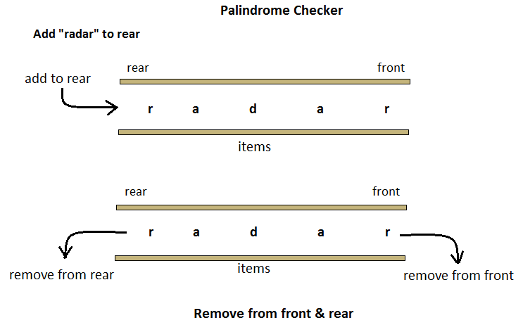
Applications
Notes:
New Courses replaced with New Programmes

Slide 71
Applications
A-Steal job scheduling algorithm
The A-Steal algorithm implements task scheduling for several processors(multiprocessor scheduling).
The processor gets the first element from the deque.
When one of the processors completes execution of its own threads, it can steal a thread from another processor.
It gets the last element from the deque of another processor and executes it.
Undo-Redo operations in Software applications.
Notes:
New Courses replaced with New Programmes

Slide 72
Code (Python)
Priority Queue using heapq (Min-Priority Queue)
import heapq
# Create an empty priority queue
priority_queue = []
# Insert elements with priority
def insert(item):
heapq.heappush(priority_queue, item)
print(item, "inserted into priority queue")
Notes:
New Courses replaced with New Programmes

Slide 73
Code (Python)
# Remove element with highest priority (smallest value)
def delete():
if len(priority_queue) == 0:
print("Priority Queue is empty")
else:
removed = heapq.heappop(priority_queue)
print("Deleted element:", removed)
# Display queue
def display():
print("Current Priority Queue:", priority_queue)
Notes:
New Courses replaced with New Programmes

Slide 74
Code (Python)
# Demonstration
insert(30)
insert(10)
insert(20)
insert(5)
display()
delete()
delete()
display()
OUTPUT:
30 inserted into priority queue
10 inserted into priority queue
20 inserted into priority queue
5 inserted into priority queue
Current Priority Queue: [5, 10, 20, 30]
Deleted element: 5
Deleted element: 10
Current Priority Queue: [20, 30]
Notes:
New Courses replaced with New Programmes

Slide 75
Code (C++)
// C++ program to demonstrate the use of priority queue
#include <iostream>
#include <queue>
using namespace std;
// driver code
int main()
{
int arr[6] = { 10, 2, 4, 8, 6, 9 };
Notes:
New Courses replaced with New Programmes

Slide 76
Code (C++)
// defining priority queue
priority_queue<int> pq;
// printing array
cout << "Array: ";
for (auto i : arr) {
cout << i << ' ';
}
Notes:
New Courses replaced with New Programmes

Slide 77
Code (C++)
cout << endl;
// pushing array sequentially one by one
for (int i = 0; i < 6; i++) {
pq.push(arr[i]);
}
// printing priority queue
cout << "Priority Queue: ";
while (!pq.empty()) {
cout << pq.top() << ' ';
pq.pop();}
return 0;
}
Find the Complete code here.
Notes:
New Courses replaced with New Programmes

Slide 78
Check Your Understanding
Why was the circular queue introduced?
What condition indicates overflow in a circular queue?
Which queue removes elements based on priority?
What is the time complexity of enqueue and dequeue in a circular queue?
Notes:
New Courses replaced with New Programmes

Slide 79
Check Your Understanding (Answers)
To utilize vacant spaces at the beginning of array
(rear+1) % n == front
Priority Queue
O(1)
Notes:
New Courses replaced with New Programmes

Slide 80
Points to Remember
A queue is a FIFO data structure in which the element that is inserted first is the first one to be taken out.
The elements in a queue are added at one end called the rear and removed from the other end called the front.
In the computer ’s memory, queues can be implemented using both arrays and linked lists.
Notes:
New Courses replaced with New Programmes

Slide 81
Points to Remember
The storage requirement of linked representation of queue with n elements is O(n) and the typical time requirement for operations is O(1).
In a circular queue, the first index comes after the last index.
Multiple queues means to have more than one queue in the same array of sufficient size.
Notes:
New Courses replaced with New Programmes

Slide 82
Points to Remember
A queue is a FIFO data structure in which the element that is inserted first is the first one to be taken out.
The elements in a queue are added at one end called the rear and removed from the other end called the front.
In the computer ’s memory, queues can be implemented using both arrays and linked lists.
Notes:
New Courses replaced with New Programmes

Slide 83
Points to Remember
A deque is a list in which elements can be inserted or deleted at either end. It is also known as a head tail linked list because elements can be added to or removed from the front (head) or back (tail). However, no element can be added or deleted from the middle. In the computer’s memory, a deque is implemented using either a circular array or a circular doubly linked list.
In an input restricted deque, insertions can be done only at one end, while deletions can be done from both the ends. In an output restricted deque, deletions can be done only at one end, while insertions can be done at both the ends.
Notes:
New Courses replaced with New Programmes

Slide 84
Points to Remember
A priority queue is a data structure in which each element is assigned a priority. The priority of the element will be used to determine the order in which the elements will be processed.
When a priority queue is implemented using a linked list, then every node of the list will have three parts:
the information or data part,
the priority number of the element, and
the address of the next element
Notes:
New Courses replaced with New Programmes

Slide 85
Key Takeaways
Queue is fundamental for fair and ordered processing (FIFO).
It is widely used in CPU scheduling, printer spooling, BFS, networking, and traffic systems.
Circular queues improve space utilization over linear array queues.
Priority queues process elements based on priority, not arrival time.
Most queue operations (enqueue/dequeue) run in O(1) time.
Choosing the right queue type improves performance and resource utilization.
Notes:
New Courses replaced with New Programmes

Slide 86
References
Textbooks
Cormen, T. H., Leiserson, C. E., Rivest, R. L., & Stein, C., Introduction to Algorithms, MIT Press.
Lipschutz, S., Schaum’s Outline of Data Structures with C++, McGraw-Hill Education.
Reference Books
Weiss, M. A., Data Structures and Algorithm Analysis in C++, 5th Edition, Pearson Education.
Skiena, S. S., The Algorithm Design Manual, 3rd Edition, Springer.
Online Resources
GeeksforGeeks – Queue Applications https://www.geeksforgeeks.org/queue-data-structure/
JavaTpoint – Queue & Circular Queue https://www.javatpoint.com/data-structure-queue
Scaler – Circular Queue https://www.scaler.com/topics/data-structures/queue-in-data-structure/
Simplilearn – Priority Queue https://www.simplilearn.com/tutorials/data-structure-tutorial/priority-queue-in-data-structure
Programiz – Queue in Python https://www.programiz.com/dsa/queue
Notes:
New Courses replaced with New Programmes

Slide 87
THANK YOU

